Slide 1
The Hunger Games
Cassandra Golden Sampson MS, RD, LDN
Registered Dietitian

Slide 2
Agenda
Ghrelin, Leptin and Dopamine
How surgery changes things
Redefining hunger and fullness
Practical daily habits to improve your hunger control to assist with weight loss

Slide 3
Hello Hunger
Hunger is a deeply biological process in our body
If you’ve been conditioned to ignore hunger and not eat all day up until this point…Listen UP!
Ghrelin is the hunger hormone that triggers our brain that we must eat
It’s what sends the signal to our brain that we must eat
Ghrelin is released from cells in the stomach and rises during times of fasting
The levels drop after eating
It is also a short acting hormone. This means will not go away until you have eaten, and it does get more intense (leading to a binge)

Slide 4
Ghrelin, Leptin and Dopamine
Leptin is another appetite hormone
It was the first hormone discovered related to our appetite
It wasn’t discovered by scientists until 1994!
Leptin is an opposite hormone to ghrelin
Ghrelin makes you feel hungry & leptin is what makes you feel not hungry.
It is the “satiety” hormone or what helps you feel satiated or satisfied
Excess weight can cause leptin resistance which means the brain does not get the message to be satisfied

Slide 5
Ghrelin, Leptin and Dopamine
Dopamine is a neurotransmitter that plays a big role in how we feel pleasure
Without dopamine we would not feel enjoyment
Dopamine affects many parts of our behavior and our mood which IS interconnected with our desire to eat
It activates pleasure centers in the brain
Eating increases dopamine.
Many studies show more dopamine is released with high fat and high sugar foods
It’s what makes us feel as though we are addicted

Slide 6
How surgery changes things
Spoiler alert: the surgery doesn’t completely eliminate hunger for the rest of your life
The surgery DOES set you up for success in managing your hunger more easily than before

Slide 7
How surgery changes things
With Gastric Sleeve surgery, approximately 70% of the stomach is removed including the fundus of the stomach or the curved part of the stomach
This curved part of the stomach is where ghrelin is produced
Since ghrelin is the hunger hormone, the sleeve is promoted as both portion restricting and greatly reducing hunger
Studies have shown ghrelin is reduced by as much as 70% as a result of the gastric sleeve surgery and that can last more than 24 months

Slide 8
Summary: Gastric Sleeve
Approximately 70% of the stomach is removed - allowing portion restriction
In addition, the portion of the stomach removed decreases ghrelin
Gastric sleeve is often marketed that you eat less and feel less hunger

Slide 9
How surgery changes things
With bypass surgery, portion restriction and malabsorption are the two mechanisms to achieve weight loss
The first step the surgeon does is make the stomach smaller. The second step is to bypass parts of the small intestine which is the malabsorptive piece of the equation.
So, you cannot eat as much after a bypass surgery and you do not absorb all of the calories that you eat
Research has shown circulated levels of ghrelin decline after the bypass which means less feelings of hunger

Slide 10
Summary: Gastric Bypass
Two main mechanisms for weight loss are portion restriction and malabsorption of calories.
Bypass is often marketed that you cannot eat as much, and you do not absorb as much.
*Dumping syndrome is more common so those with a strong sweet tooth might be encouraged against having the Bypass.

Slide 11
Dumping syndrome
Generally avoidable
Occurs after eating food/drink with high amounts of added sugar
These concentrated sugars absorb water from the body as they pass through the intestines
Symptoms include abdominal pain, diarrhea, nausea, vomiting, dizziness, flushing, palpitations, tachycardia, and hypotension
Primarily happens in bypass patients
Prevalence ranging from 40% to 75% of bypass patients (depending on their food/beverage choices!)

Slide 12
Still hungry?
Even if you feel hungry shortly after your surgery, it does not mean your surgery didn’t work.
There is far more unseen improvement going on in your body than you may feel or know.
Don’t let short term discouragement lead you down the wrong path!
Surgery is like hitting a giant reset button on metabolism and hormones, and what you do in the first year out of surgery to make healthy habits will set you up very well for long-term weight management.
Continuing to practice healthy lifestyle habits is never a waste of time or effort – even if your hunger is present.

Slide 13
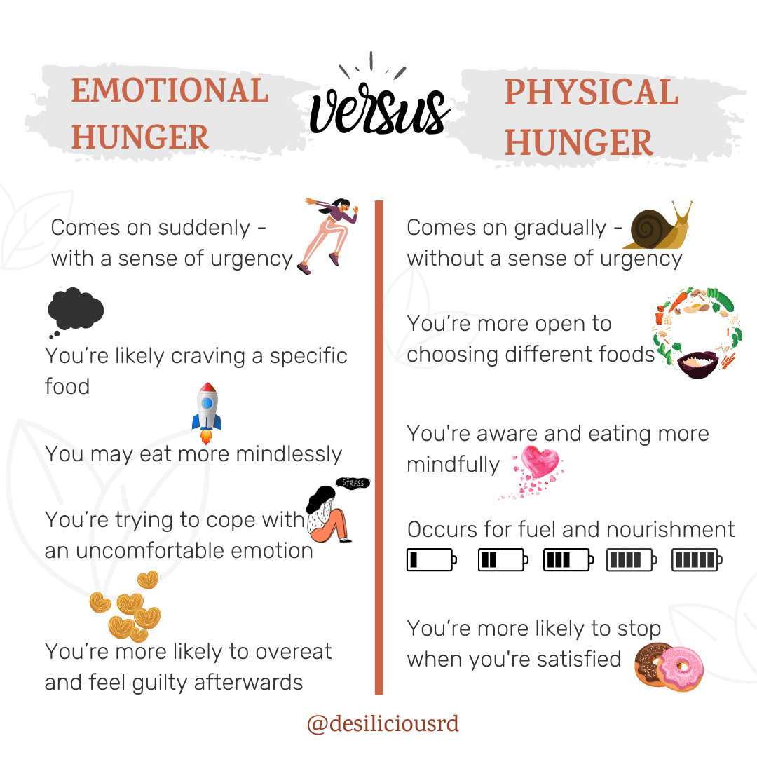
Redefining hunger:

Slide 14
Redefining hunger
Don’t forget about these under recognized causes of increased hunger:
Living in survival mode due to chronically high stress
Poor sleep patterns/habits
Lack of water intake
Imbalances in the gut microbiome
Post-op patients:
How did your hunger signals change after surgery?
How do you know when to eat if you’re not hungry?

Slide 15
Genetics
Genetics can affect dopamine and how other brain chemicals work.
Someone’s genetic makeup may give them fewer dopamine receptors which can lead to a higher risk for addictive behaviors such as drugs, alcohol or food.
In fact, this is why many bariatric practitioners do a deep dive into hard conversations about transfer addictions
Research tells us that patients after Gastric Bypass and Gastric Sleeve have a higher risk of struggling with alcoholism.
Genetics is not always destiny!
Your home environment, the support you have in your life, your ability to manage stress, your daily routines and habits…it can all overcome genetics.

Slide 16
Water
Water is your secret weapon for hunger control.
The brain gets thirst confused with hunger.
Staying hydrated allows you to identify if you are truly hungry.
Aim for 64 to 96 ounces of hydrating fluids. I count something hydrating if it is not caffeinated, no added sugar, not carbonated and under 15 calories for 8 ounces.
While water is the top priority in between meals, it really should be avoided right before, during and after meals (30 minutes).
Drinking with or too soon after a meal will increase food transit time through the stomach pouch, leaving you hungry sooner.

Slide 17
Protein
We hear about protein ALL the time.
The texture really matters for controlling your hunger.
Liquid protein (protein shakes) will leave the pouch the fastest and you can drink more in a liquid than you can eat in a solid. This can work against long-lasting fullness.
Many patients think of pumping up their protein by drinking more protein shakes. While liquid protein is incredibly helpful in the healing stages after surgery, it is not as helpful in controlling hunger.
Soft protein (cottage cheese, Greek yogurt, flaky fish, tuna salad, etc.) goes down easy but leaves more quickly. This does not promote long-lasting fullness.
Soft proteins are encouraged when someone is having discomfort from eating too fast or too large of bites.

Slide 18
Protein
Sticking to liquid or soft proteins past the healing phase of diet can cause hunger control issues later.
Solid, lean protein (chicken, lean beef, pork, etc) will fill the pouch will a smaller amount and keep hunger away the longest.
You do have to take small bites, eat slowly and stop at the first sign of fullness
If you pay attention to how to eat the solid protein most comfortably, you will be full on a small amount and stay full longer…especially when you don’t drink before, during or after.
Protein takes a long time to digest, it drops your ghrelin and being aware of the differences in texture can really help you manage your hunger.

Slide 19
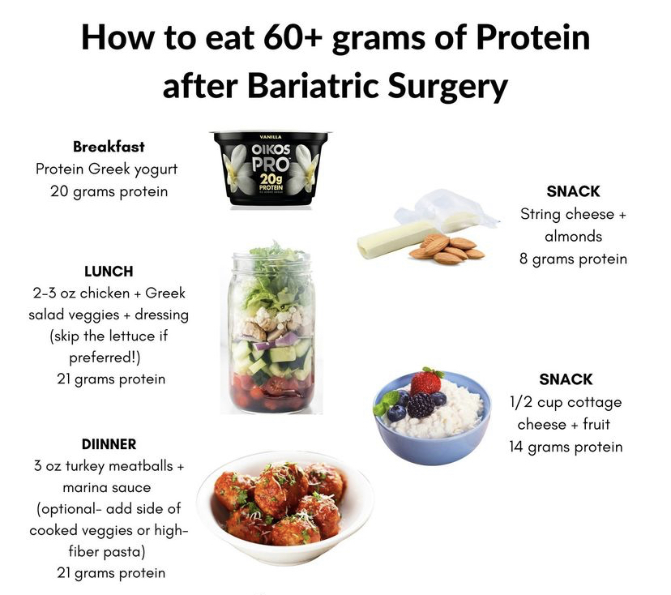

Slide 20
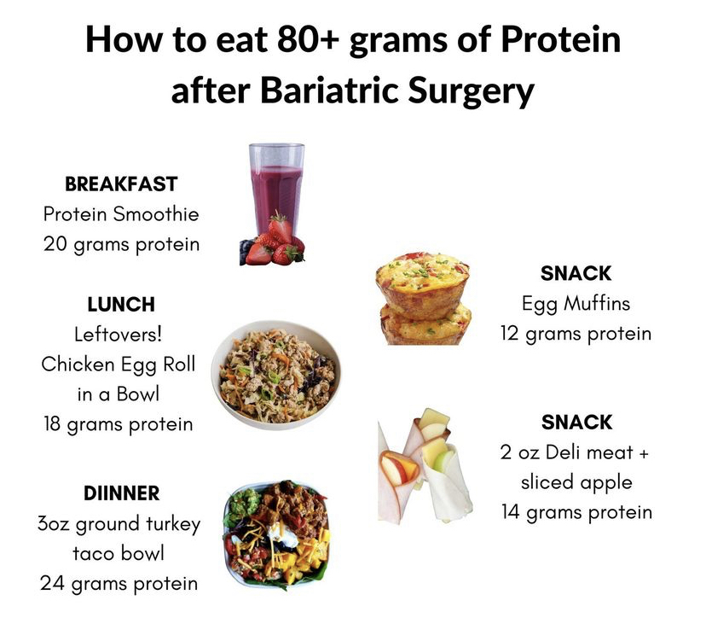

Slide 21
Premature fullness
POST-OP PATIENTS: Have you ever felt physically full after just a couple bites and feel hungry just an hour or two later?
This can cause a grazing pattern for patients because they just can’t eat more at their mealtime but also feel hungry all day.
This is a symptom of what I call premature fullness.
Feeling full prematurely often comes from eating too fast or too large of bites.

Slide 22
Premature fullness
Your stomach is three layers of muscle and when that muscle stretches a little, it will signal fullness to your brain.
After surgery, you have a smaller opening into your small pouch and having a bite of chicken that was a little too large can cause that stretching experience on the stomach which signals you to stop eating.
Same is true for having your bites back to back too quickly.
If you eat fast and take big bites after surgery…these are incredibly hard habits to break.
Eating behaviors play a big role in staying in control of hunger. Slow down, take small bites and stay in tune to your cues from your body.

Slide 23
Premature fullness
TIPS:
Cut bites before you start eating in case you get distracted.
If you pack your lunch for work you might even cut it all up the night before so you are ready!
An ideal bite size is about a black bean in size or even your pinkie fingernail for a visual you always have on hand.
Put your fork down in between your bites and ask yourself between each one if you feel satisfied or if you need to eat more.
As you do this, you’ll notice you can eat more at your meal than just a couple bites and I don’t want you to be scared about that.
This is a good thing because its far better to fill up on your quality meal at the correct mealtime than feel hungry too soon after and end up grazing all day

Slide 24
Redefining fullness
One of the known causes of pain, nausea and vomiting is eating too much (past the first feeling of comfortable fullness)
The sensation of fullness will likely feel different after surgery
It is important to have an open mind when it learning your new body signals
Post-op patients have described their new fullness signals as:
A very “hard stopping point”
Feeling bloated
A pressure in the upper stomach area
Hiccups
Runny nose
Sneezing
Post-op patients: how does your body indicate you’re full?

Slide 25
Hungry foods
Lonely carbohydrates will leave you feeling hungry sooner
If you’re going to have carbs:
As ALWAYS, be mindful and cautious about portion size
Pair the carbs with protein
Adding the protein will slow down the absorption of the sugar into your body
Refined carbs and simple sugars get absorbed into the bloodstream quickly – but don’t cause a feeling of fullness for very long. That donut or cupcake will leave you feeling hungry!
The less nutritious carbs also activates the dopamine response, increasing our desire for more carbs.

Slide 26
Complex carbs
Absorbed slower in the body, which keeps us full and doesn’t cause a spike in blood sugar.
Two types of complex carbs: These sugars occur naturally.
Starches: from 100% whole grain breads and cereals, brown rice, whole wheat pasta, peas, corn, beans and some vegetables
Fiber: fruits, vegetables, nuts, beans and whole grains.

Slide 27
Refined carbs
Almost all of the fiber, vitamins and minerals are removed during processing.
They are digested quickly, and have a high glycemic index.
This causes rapid spikes in blood sugar and insulin levels after meals.
Fullness after eating is only for a short period.
This is followed by a drop in blood sugar, hunger and cravings - contributing to weight gain and diabetes.
The main dietary sources of refined carbs:
White flour, white bread, white rice,
Crackers, pastries, sodas, snacks, pasta,
Sweets, and some breakfast cereals

Slide 28
Simple sugars
Food and drinks with added sugars (think: dumping syndrome)
Added sugar is easily absorbed and quickly converted into blood sugar, causing a spike.
Added sugar is known to contribute to inflammation
Sources: (highly processed foods/drinks)
Candy, fruit juice, cake, pastries, ice cream, soda, sports bars and sports drinks.
Hidden sources of added sugars: yogurt, condiments, certain types of bread, granola, breakfast bars, Gatorade, juice

Slide 29
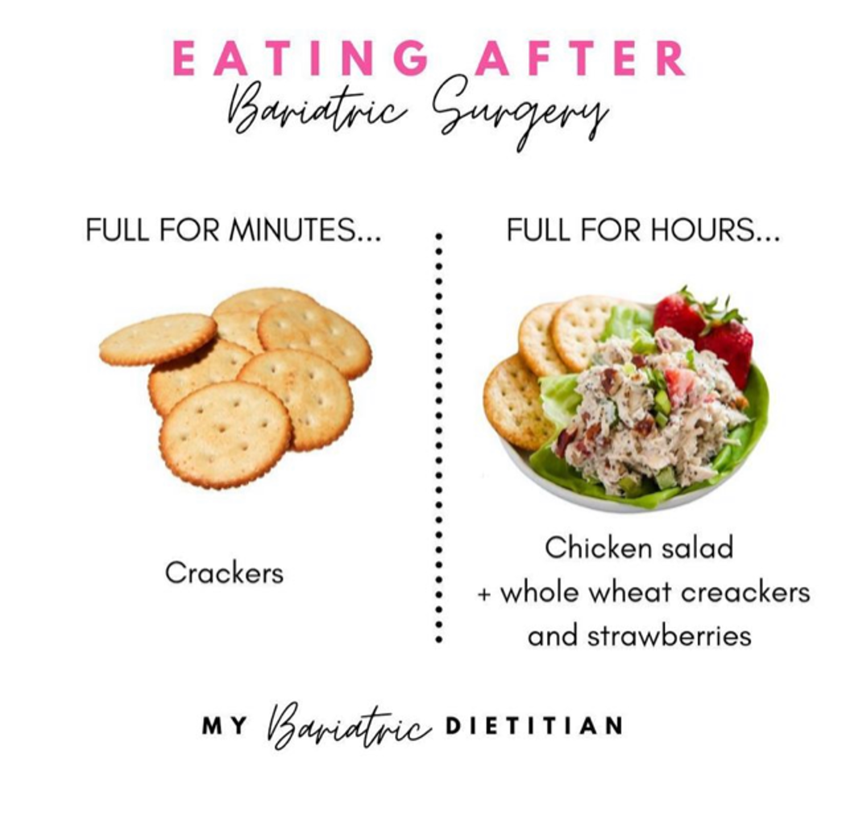

Slide 30
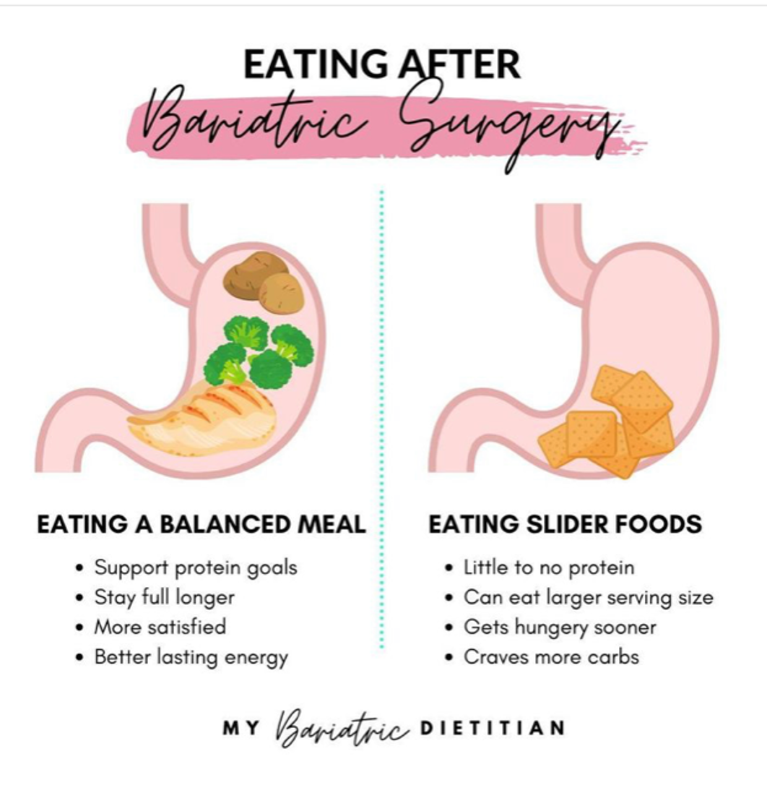

Slide 31
Strategies to control hunger
If you’re in the process of cutting back on carbohydrates, protein can be key during this time!
Studies show ghrelin drops after eating protein (helping curb your hunger).
Start your day with hydrating fluids and a lean protein breakfast.
Going too long without eating will make it difficult to slow down your pace of eating, make a mindful choice and be intentional about listening to your fullness signals if you have intense hunger working against you!
If you’re going to eat carbs, choose high fiber complex carbohydrates paired with a lean protein source (ideally not a liquid source)

Slide 32
If you’re struggling with hunger or fullness, ask yourself:
1.) Were you grazing on the food? Did you take more than 30 minutes to eat it?
Research shows patient who successfully maintain weight loss avoid grazing.
2.) Was your food a softer texture?
You will experience less restriction and be able to eat more of a softer textured food.
Examples include cottage cheese, Greek yogurt, deli meat, scrambled eggs, tuna/chicken/eggs salad. The softer the food is, the more you can fit in your pouch and the sooner you get hungry.
It’s not the stomach that’s the issue - it’s the types of foods you are eating.

Slide 33
If you’re struggling with hunger or fullness, ask yourself:
3.) Did you take small bites and pause in between?
How you eat matters!
4.) Did you drink while you ate?
Fluids will move food through your stomach much faster which will increase how much food you are able to fit in the stomach during that mealtime.
This is true for soups and cereals.

Slide 34
If you’re struggling with hunger or fullness, ask yourself:
5.) Was the food starchy or high in carbohydrate?
Starchy foods (breads, pasta, rice, crackers, chips, popcorn, oats) are higher in carbohydrates which begin the digestion process in the mouth with salivary amylase.
Between chewing and this enzyme, the food is very soft when it reaches your pouch. This means it moves through more quickly and you can eat more of it.
This is why you can eat more crackers or chips than you can hamburger.

Slide 35
Weight and hunger control is far more complex than eating less and working out harder.
Be patient with the process.

Slide 36
Mindful Eating
Mindless eating is a known cause of weight regain.
Assess the conditions of your eating environment:
Create a distraction-free zone.
Disconnect from your devices. This restores your attention, making eating an intentional act instead of an automatic one.
Give 100% of your attention to your food to fully enjoy what you are eating.
Sit at the table rather than slouched on the couch.
Sitting up straight allows for better digestion and draws attention to the feeling of fullness.
Eating slowly is important to avoid discomfort after surgery.
Take 20-30 minutes for a full meal.
Stop eating when you feel comfortably satisfied and stop before you feel full.

Slide 37
Eating techniques
Slow down your pace of eating
This allows the mind and body to communicate.
Taking your time also increases meal satisfaction by observing certain flavors and textures that are often ignored when the meal is rushed.
As you slow down, your natural fullness signals become more distinct.
Each meal should last 20-30 minutes at least.
Chew at least 20 times before swallowing
Your digestive system starts in your mouth with chewing. Chewing breaks down the food to turn it into energy that your body can use.
Prevents feeling like food is “blocked”.
Multitasking while eating can distract you from taking small bites and chewing thoroughly.
Take breaks in between bites to bring awareness to your fullness

Slide 38
Bariatric Food Coach
A bariatric support membership site
Meal plans, dining out guides, grocery shopping guides (Costco, Trader Joe’s, Aldi and Sam’s Club), coaching videos, over 500 recipes for ALL stages of the bariatric journey, meal planning templates, a member’s-only community with text message groups, and incredible ongoing support and accountability for $14 a month!
https://www.bariatricfoodcoach.com/ref/6/ (20% off coupon code: WLSPLAN20 for first time customers only)

Slide 40
Thank you
Cassandra Golden Sampson
NutritionNibbles@gmail.com
www.CassandraGolden.com

